Slide 1
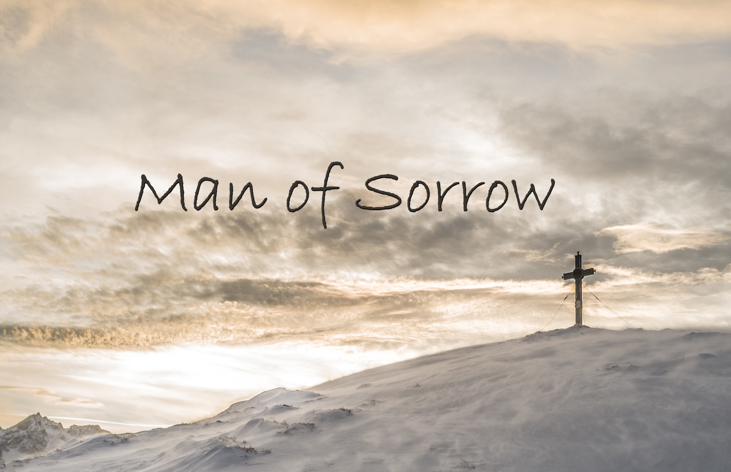

Slide 2
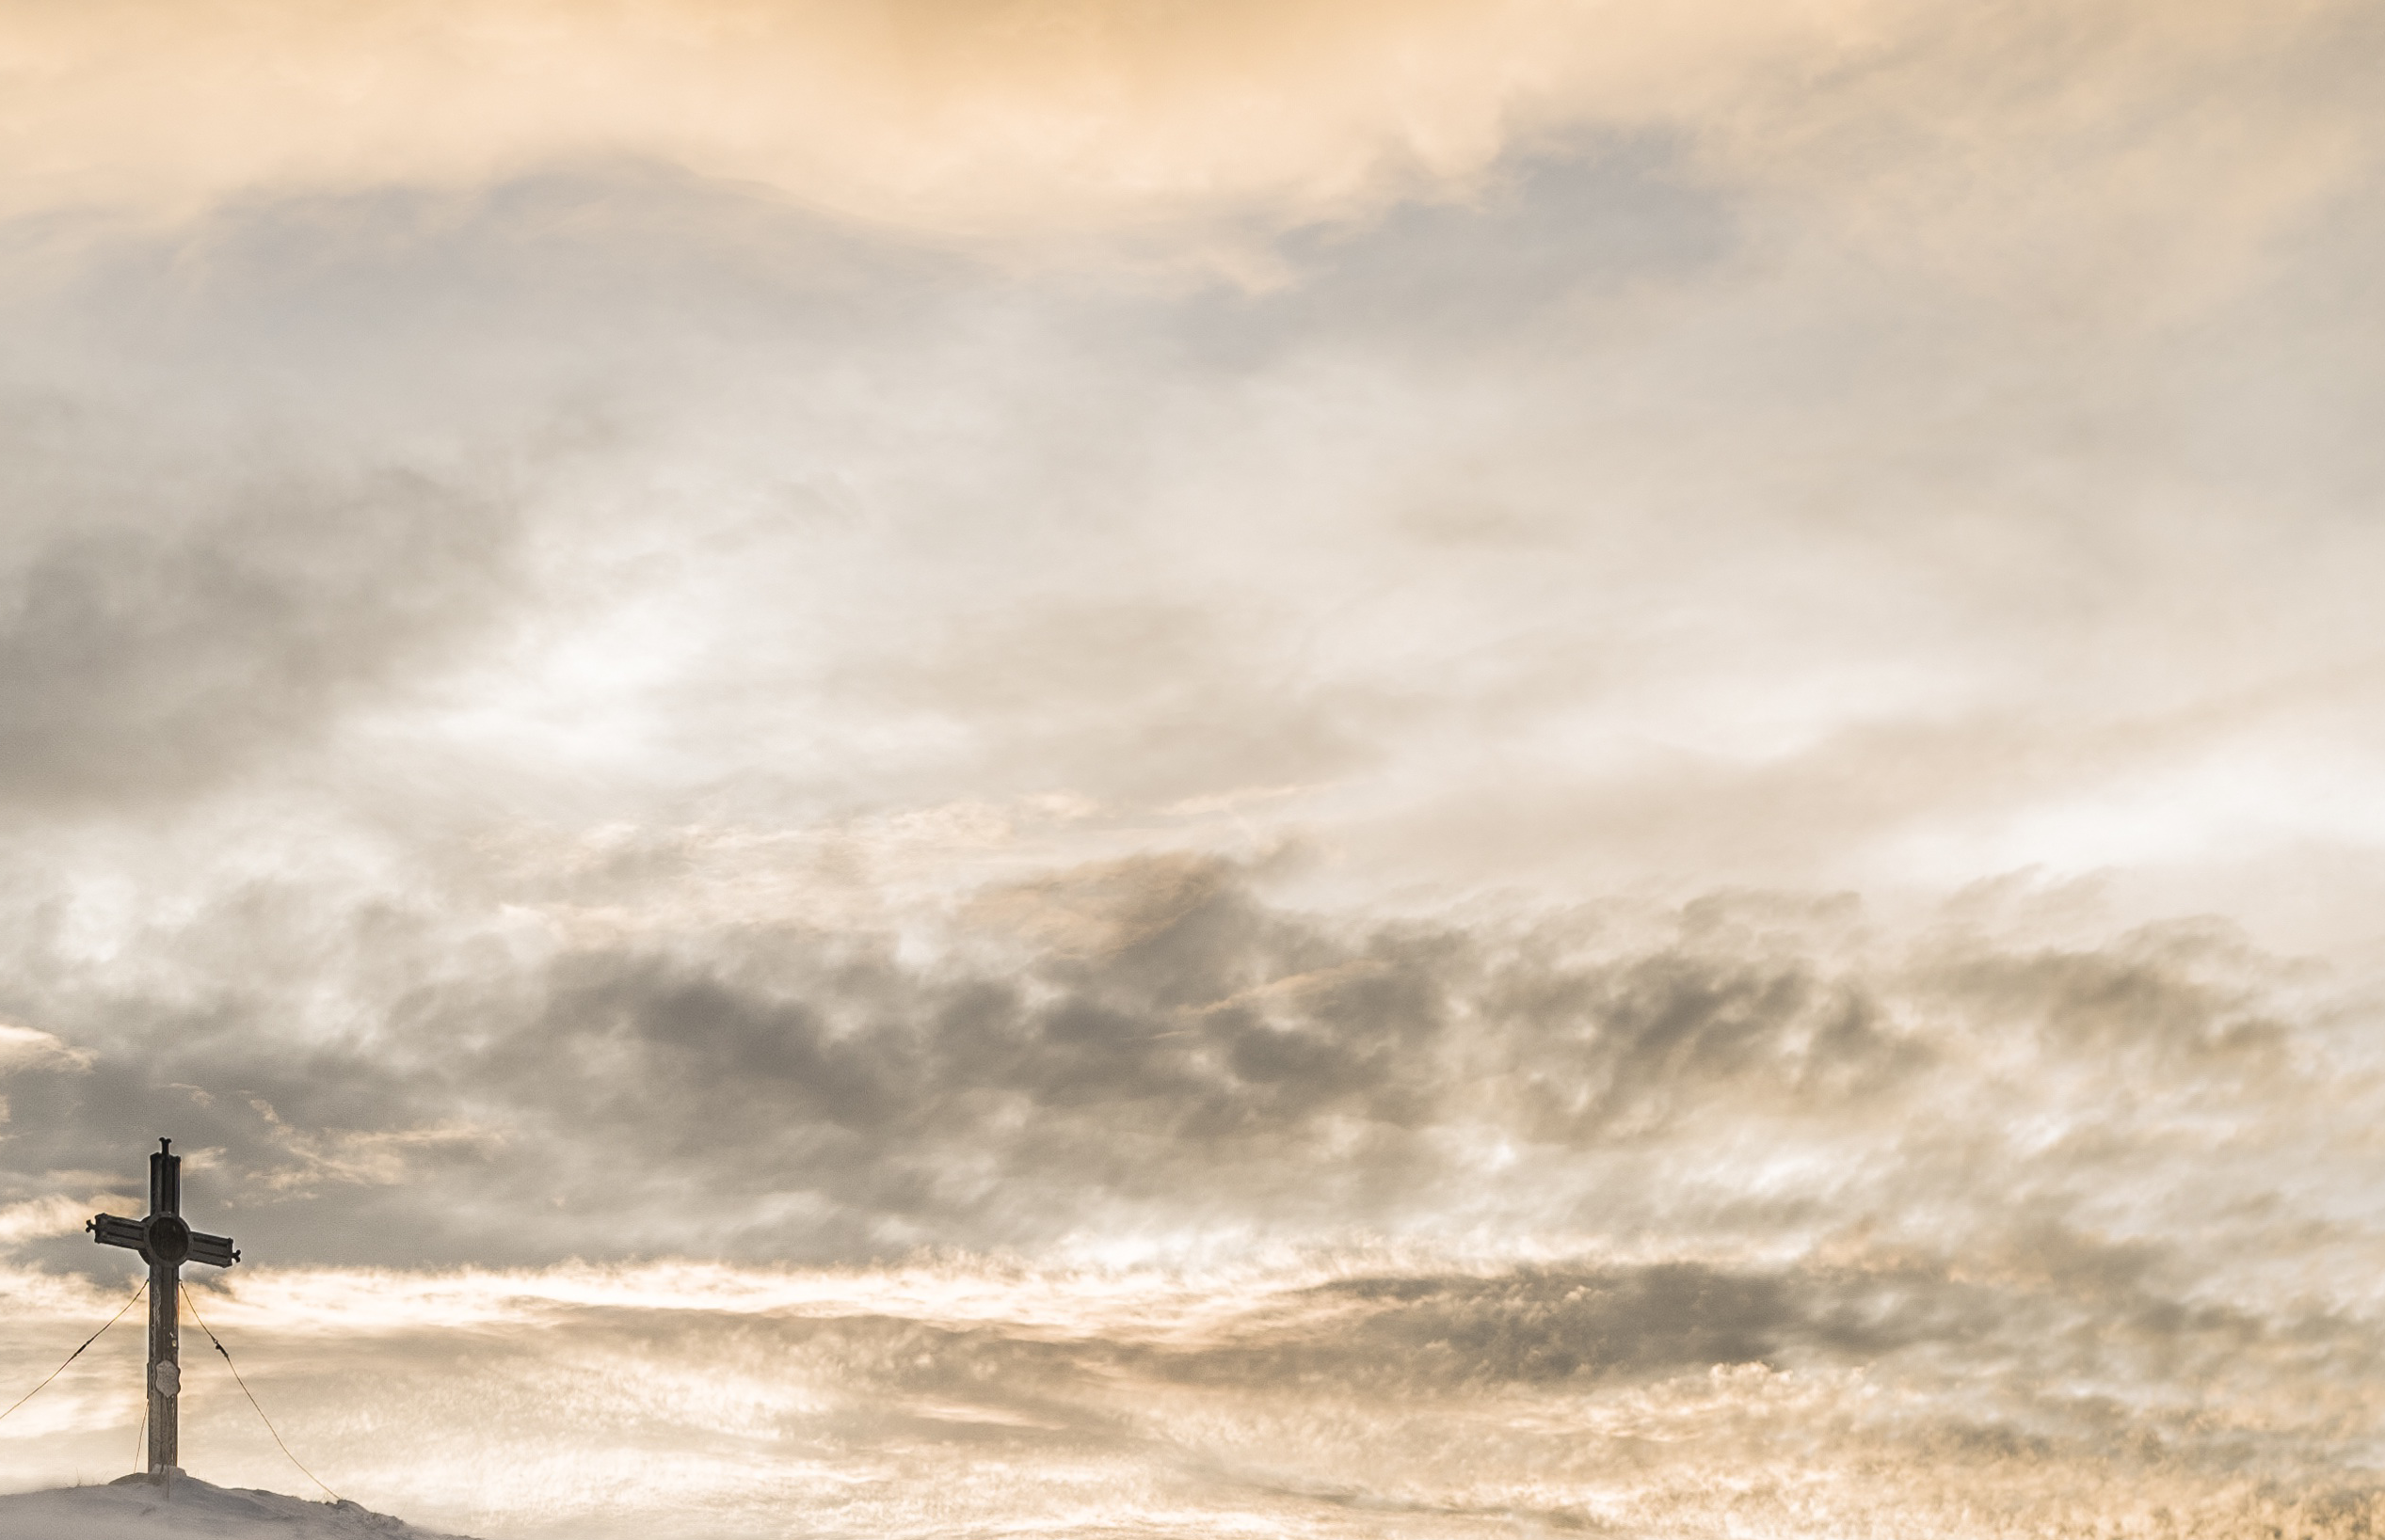
Man of sorrows Lamb of God By His own betrayed
The sin of man and wrath of God Has been on Jesus laid
忧痛人子神羔羊，遭背叛受罪苦
众人的罪神的怒，都由主担当背负
Verse1

Slide 3
Silent as He stood accused Beaten mocked and scorned
Bowing to the Father's will He took a crown of thorns
无罪被告不答辩 独受唾骂与鞭笞
顺服天父的旨意 祂戴荆棘的冠冕
Verse2

Slide 4
Oh that rugged cross my salvation
Where Your love poured out over me
哦 牢旧的十架 是我的救恩
祢的爱在那为我而浇灌
Chorus-1

Slide 5
Now my soul cries out hallelujah
Praise and honour unto Thee
现我灵呼喊 哈利路亚
赞美尊荣归于祢
Chorus-2

Slide 6
Sent of heaven God's own Son To purchase and redeem
And reconcile the very ones Who nailed Him to that tree
从天受遣神独子 来至此赎罪债
放下己心并宽恕 将祂钉十架之人
Verse3

Slide 7
Oh that rugged cross my salvation
Where Your love poured out over me
哦 牢旧的十架 是我的救恩
祢的爱在那为我而浇灌
Chorus-1

Slide 8
Now my soul cries out hallelujah
Praise and honour unto Thee
现我灵呼喊 哈利路亚
赞美尊荣归于祢
Chorus-2

Slide 9
Now my debt is paid It is paid in full
By the precious blood That my Jesus spilled
如今我罪债 全已得清偿
受清洗洁净 因主流宝血
Bridge-1

Slide 10
Now the curse of sin Has no hold on me
Whom the Son sets free Oh is free indeed
死亡的诅咒 失去了权柄
因神子解救 我得着自由
Bridge-2

Slide 11
Now my debt is paid It is paid in full
By the precious blood That my Jesus spilled
如今我罪债 全已得清偿
受清洗洁净 因主流宝血
Bridge-1

Slide 12
Now the curse of sin Has no hold on me
Whom the Son sets free Oh is free indeed
死亡的诅咒 失去了权柄
因神子解救 我得着自由
Bridge-2

Slide 13
Oh that rugged cross my salvation
Where Your love poured out over me
哦 牢旧的十架 是我的救恩
祢的爱在那为我而浇灌
Chorus-1

Slide 14
Now my soul cries out hallelujah
Praise and honour unto Thee
现我灵呼喊 哈利路亚
赞美尊荣归于祢
Chorus-2

Slide 15
See the stone is rolled away Behold the empty tomb
Hallelujah God be praised He's risen from the grave
眼看墓石挪移开 探眼只见墓已空
哈利路亚颂赞主 祂已从死里复活
Verse4

Slide 16
Oh that rugged cross my salvation
Where Your love poured out over me
哦 牢旧的十架 是我的救恩
祢的爱在那为我而浇灌
Chorus-1(end)

Slide 17
Now my soul cries out hallelujah
Praise and honour unto Thee
现我灵呼喊 哈利路亚
赞美尊荣归于祢
Chorus-2(end)

